Slide 1
Sql answer

Slide 2
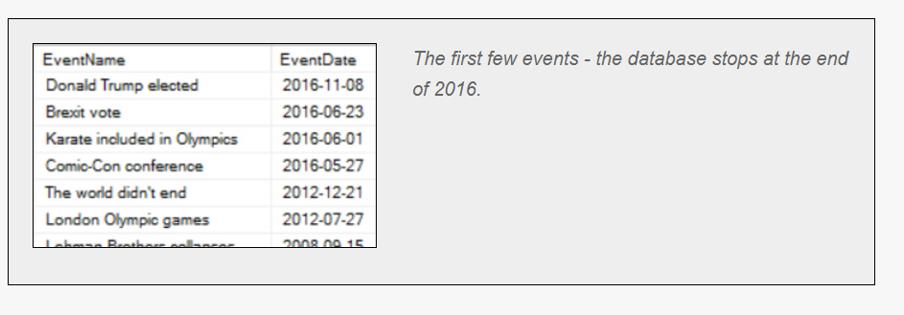
Question1.
Create a query to list out the following columns from the tblEvent table, with the most recent first (for which you'll need to use an ORDER BY clause):
The event name
The event date

Slide 3
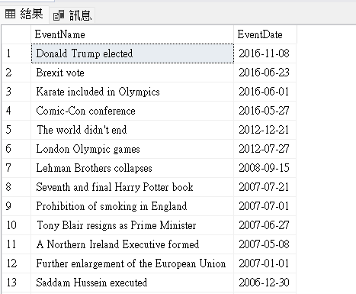
Answer1.
SELECT e.EventName,e.EventDate
FROM WorldEvents.dbo.tblEvent as e
ORDER BY e.EventDate DESC
ORDER BY : 根據某個table來做排序
DESC:由大到小
ASC:由小到大(預設

